Slide 1
‘Supporting Those Who Are Bereaved’ Faith In Later Life Thursday 10 November 2022 Reverend Cassius Francis

Slide 2
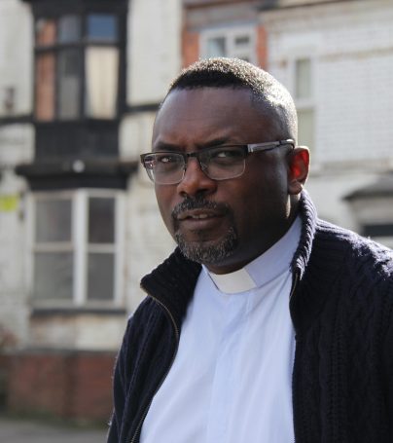
Reverend Cassius Francis is the Church Trainer & Resourcer with Loss and HOPE, a coalition project equipping churches in bereavement support, and a minister with the Wesleyan Holiness Church.
To find out more about the bereavement support available see www.ataloss.org
Email: cassius@lossandhope.org

Slide 3
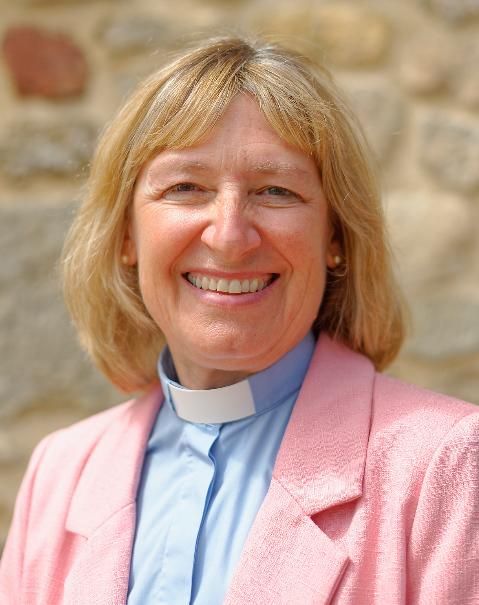
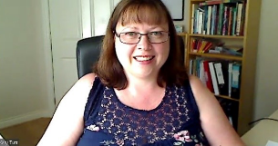
Rev Canon Yvonne Richmond Tulloch
CEO, AtaLoss (signposting: ataloss.org)
Director, Loss and HOPE (equipping churches: lossandhope.org)
Leader of HTB’s The Bereavement Journey (thebereavementjourney.org)
Katy Tutt
Project Manager, Loss and HOPE

Slide 4
Format for the webinar…
Why bereavement support?
How do we offer bereavement support?
Questions from you and Adsum?

Slide 5
Why Bereavement Support?
Lack of Understanding - of Grief
Grief is a natural response to loss
Affects every aspect of life
– emotional, physical, mental, relational, spiritual, etc.
Roller coaster
Practical & financial challenges & change
One of the greatest stresses in life
Can be devastating
Often the greatest pain is later

Slide 6
Why Bereavement Support?
Lack of Understanding – Death Denial
Lack of expectation of death
Avoidance
Wrong assumptions
Unhelpful responses
Poor signposting
Isolation & confusion

Slide 7
Why Bereavement Support?
Scale of Bereavement
Universal experience
Per annum: 600,000 deaths – 6M+ bereaved
+ those bereaved previously
More younger people than older
Almost everyone?

Slide 8
Why Bereavement Support?
Under Capacity
Counsellors oversubscribed
Long waiting lists
Most people don’t need specialist help
Mental health services turned to
GPs - antidepressants

Slide 9
Why Bereavement Support?
Negative Outcomes
The grief journey is necessary
It’s not a mental health problem
BUT can lead to mental ill-health – sooner or later
And:
relationship & behavioural problems
job loss, debt, homelessness
under achievement, substance abuse, crime, etc

Slide 10
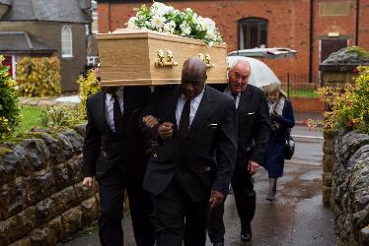
Why Bereavement Support?
Faith Questioning
Purpose, God, afterlife
Churches uncomfortable places
Affects all

Slide 11
Why Bereavement Support?
The Pandemic (1.2M deaths)
Bereavement problems exacerbated
Unable to: say goodbye, have desired funeral/attend funeral, be comforted
Sudden, untimely deaths
Support services restricted
Disproportionately affected groups
Grief complicated & on hold

Slide 12
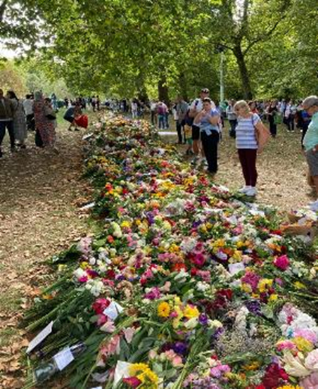
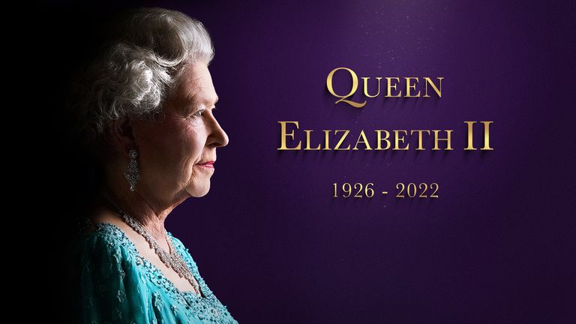
The Queen’s Death
Widespread unprocessed grief

Slide 13
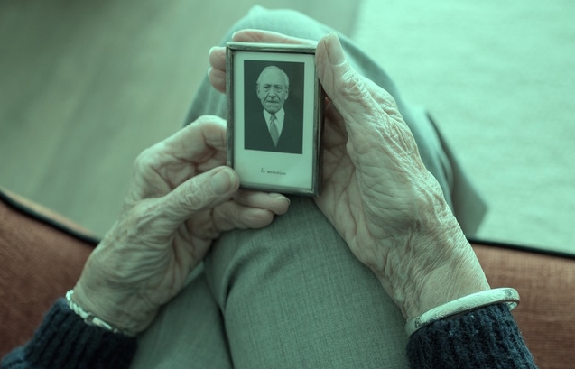
Why Bereavement Support?
CofE Life Events Research 2020/2021
35% had thought about their own death
And 26% about whether there is life after death
90%+ (definitely or may) expect church to help them with grief:
- listening ear
- opportunity to talk
- practical help
- spaces for reflection

Slide 14
Why Bereavement Support?
Talking Jesus Research 2022 (Hope Together)
“A life event (positive or negative) is the biggest influence in bringing adults to faith”

Slide 15
How do we offer bereavement support?
See: https://thebereavementjourney.org/

Slide 16
How do we offer bereavement support?
https://vimeo.com/408350390

Slide 17
How do we offer bereavement support?
Affirm God’s love (model it)
Lots of practical support
Telephone/visiting group
Teach new skills
Signpost (www.ataloss.org – website, funerals, service sheets, foyer)

Slide 18
How do we offer bereavement support?
Facilitated drop in
Walk & Talk group
Prepare for good deaths (e.g. Grave Talk, Death Café)
Younger people helping elderly/blind access support (e.g. AtaLoss.org, The Bereavement Journey)

Slide 19
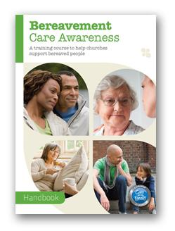
How do we offer bereavement support?
Bereavement Care Awareness – for everyone (Care for the Family)
- Supporting individuals through grief
See www.lossandhope.org

Slide 20
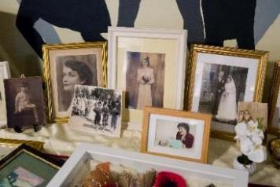
How do we offer bereavement support?
Bereavement Friendly Church - for church leaders
- Considering church accessibility for bereaved people
See www.lossandhope.org

Slide 21
The Bereavement Journey® - A place to talk
6 Sessions of films and facilitated discussion
www.thebereavementjourney.org

Slide 22
The Bereavement Journey® - A place to talk
Sessions cover:
The impact of past losses
Understanding one’s own reactions (including anger & guilt)
Coping with the reactions of others
Avoiding and delaying grief
Healthy remembering
Moving forward positively
A Christian response to commonly answered faith questions

Slide 23
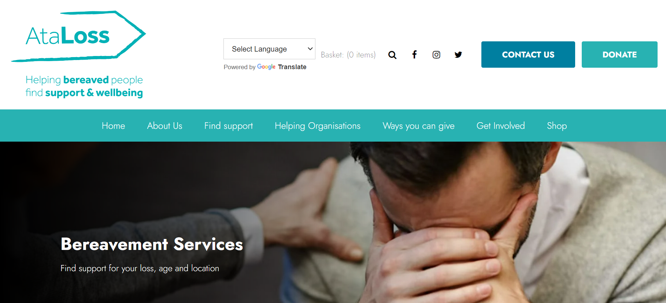
The Bereavement Journey® - A place to talk
At very least
Tell people about TBJ courses running
both locally and nationally (see www.thebereavementjourney.org/locations)
& Signpost: www.ataloss.org

Slide 24
Funeral Service for the late Inez Pauline Pemberton – Friday 27 August 2021 https://youtu.be/drZGa94qVV8

Slide 25
Any Questions?

Slide 26
www.lossandhope.org
www.ataloss.org
www.thebereavementjourney.org
Follow us on Facebook:
@lossandhope1 @thebereavementjourney
And Twitter:
@lossandhope1 @thebereavementj
Sign up to our newsletter on www.lossandhope.org

