Slide 1
Evangelism
How to Share our Faith Sensitively Beyond the Church.

Slide 2
Reaching Those in Later Life
‘Do not cast me away when I am old;
do not forsake me when my strength is gone’.
Psalm 71:9

Slide 3
hungry
For I was hungry and
you gave me something to eat,
I was thirsty and you gave me something to drink,
I was a stranger and you invited me in,
I needed clothes and you clothed me,
I was sick and you looked after me,
I was in prison and you came to visit me.’
Matthew 25:35-36
something to eat
thirsty
something to drink
stranger
invited me in
needed clothes
clothed me
sick
looked after me
prison
came to visit me
Word and Deed

Slide 4
‘Whatever you did for one of the least of these… you did for me.’

Slide 5
A Journey – not Just a Conversation

Slide 6
Not just a conversation…
Florrie – Telephone loop
June – “If I commit suicide will I go to hell?”
George a former Paratrooper, now retired.

Slide 7
‘Listen for fifty-five minutes’
When Francis Schaeffer was asked what he would do if he had an hour with a non-Christian, he replied by saying he would listen for fifty-five minutes. Then, in those last five minutes, he would have something to say.

Slide 9
Entry Points for the Gospel
Small Story – BIG STORY
People’s stories are important
Joys
Sorrows
Regrets
Defining moments
Jesus knew their story – Nathaniel “I saw you…”
Rich young ruler
Women at the well

Slide 10
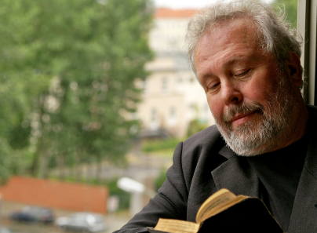
Even when I am old and grey, do not forsake me O God, as I declare your power to the next generation… Psalm 71:17-18
Retired People have many opportunities to
Meet others and build friendships
Visit Shut-ins
Join local clubs and activities
Be a regular at a local Café
Seniors can be genuine salt and light in the local community.
Let’s encourage our older members to see their evangelistic potential and not to forsake the great message of hope in the face of death.
Notes:
Added – Visit Shut-ins – slide might need adjusting.

Slide 11
Charles Wesley
Oh, that the world might taste and see
The riches of His grace
The arms of love that compass me
Would all mankind embrace

Slide 12
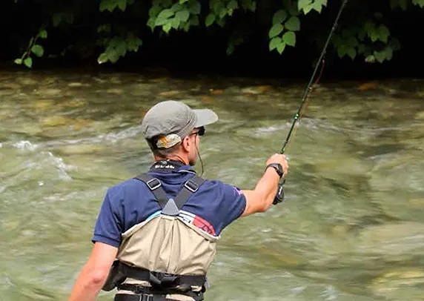
Fishing Be Prepared Choosing the right bait or lure.

Slide 13
Look at what is around you. Beautiful yellow rose. Man on the doors in Tottenham. Jesus illustrated from the everyday things around him

Slide 14
Duncan Bannatyne – Dragon’s Den
“I found a quiet place at the side of the house. I couldn’t stop the tears. I had no choice but to let the tears flow; and they just kept pouring out of me and wouldn’t stop. After many minutes, I began to get the feeling that I wasn’t alone. It was there and then that God said hello. It was unmistakable: I knew who had come, and I also knew why. It wasn’t a spiritual thing, it was a Christian thing. It was profound, and I stood there, stunned, considering the offer and thinking about what it would mean.”

Slide 15
Can I tell you what I was reading this morning?

Slide 17
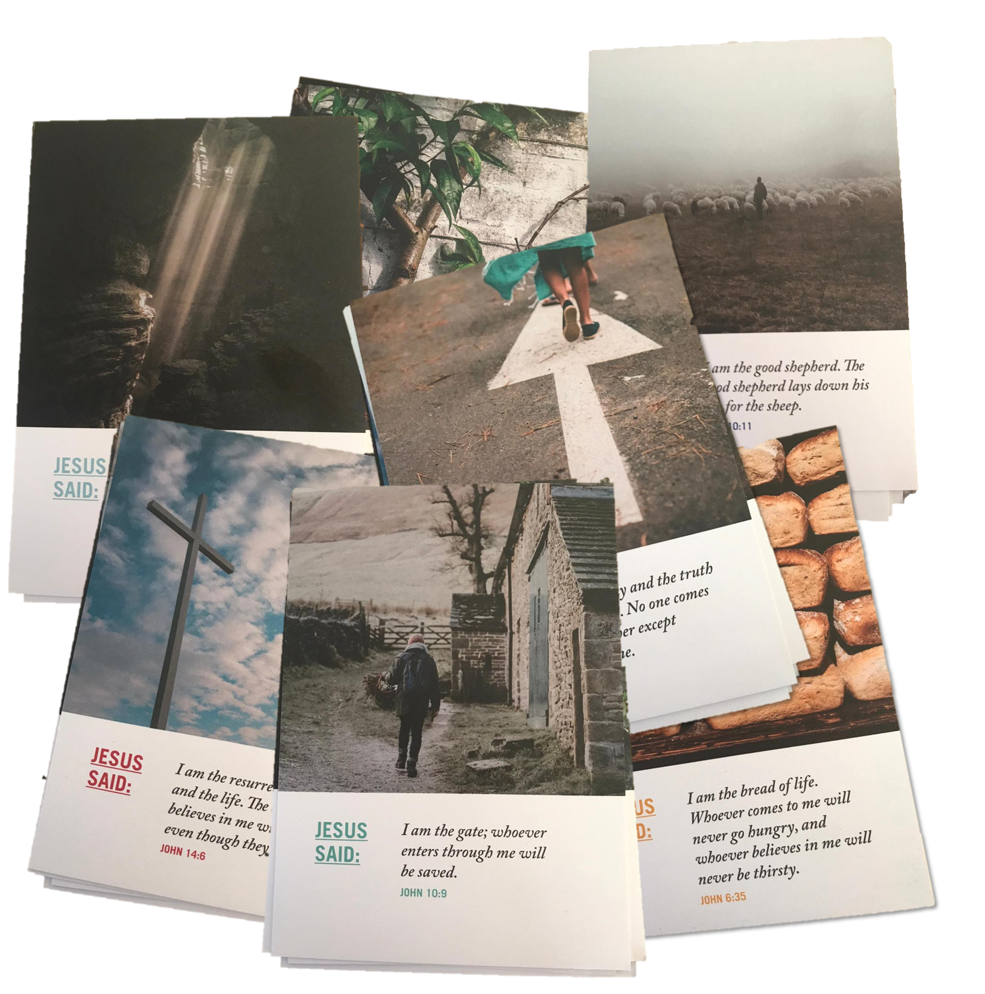

Slide 18
How shall they hear?
Jesus performed many other signs in the presence of his disciples, which are not recorded in this book. But these are written that you may believe that Jesus is the Messiah, the Son of God, and that by believing you may have life in his name.
John 20:30-31
Faith comes by hearing, and hearing by the word of God.
Romans 10:17
Journey
Questions
Can I pray with you?
Can I read the Bible with you?

