Slide 1
A Great Place to Grow Old
Re-imagining ministry amongst older people

Slide 2
Working towards a world where older people are
valued, connected and full of hope
Combatting loneliness
Mobilising volunteers
Equipping churches
Speaking out
Care Home Friends
Carers Connected

Slide 3
1. An Ageing Population
Number of Centenarians increased by 85%
By 2030 1 in 5 people will be over 65
Over 85 age group forecast to double in the next 20 years
2. An Ageing Congregation
In 2000 25% of congregation were over 65. Forecast to rise to 45% by 2030
In 2000, 5% of the over 65’s were 85+. Forecast to rise to 19% by 2030

Slide 4
3. The church should be a good place to grow old.
“Old men and old women will come back to Jerusalem, sit on benches on the streets and spin tales, move around safely with their canes—a good city to grow old in. And boys and girls will fill the public parks, laughing and playing—a good city to grow up in.”
[Zechariah 8:4-5, The Message]

Slide 5
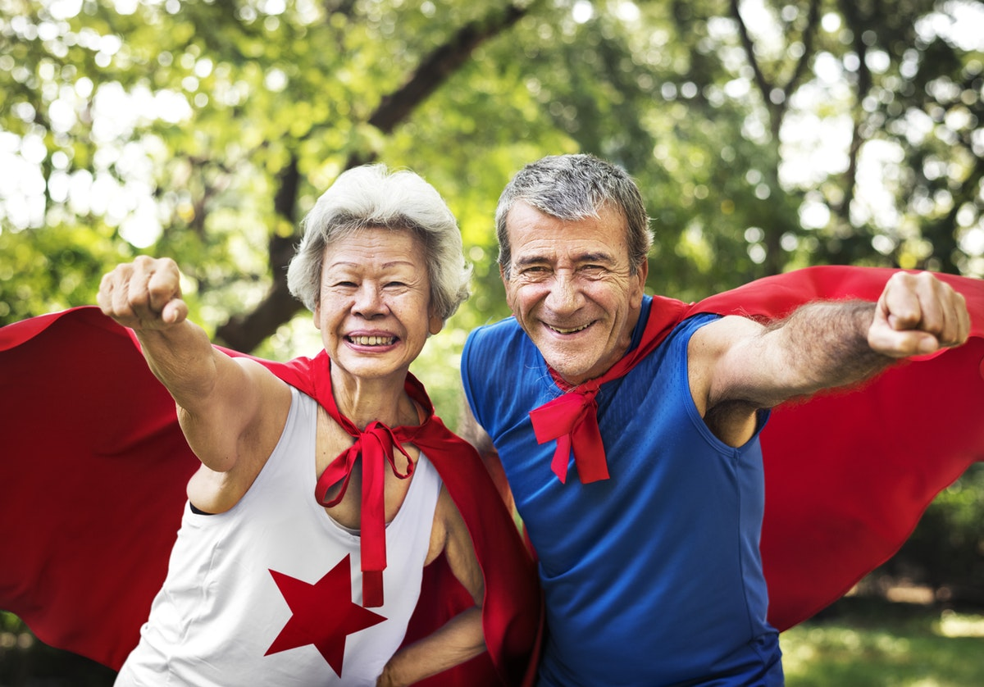
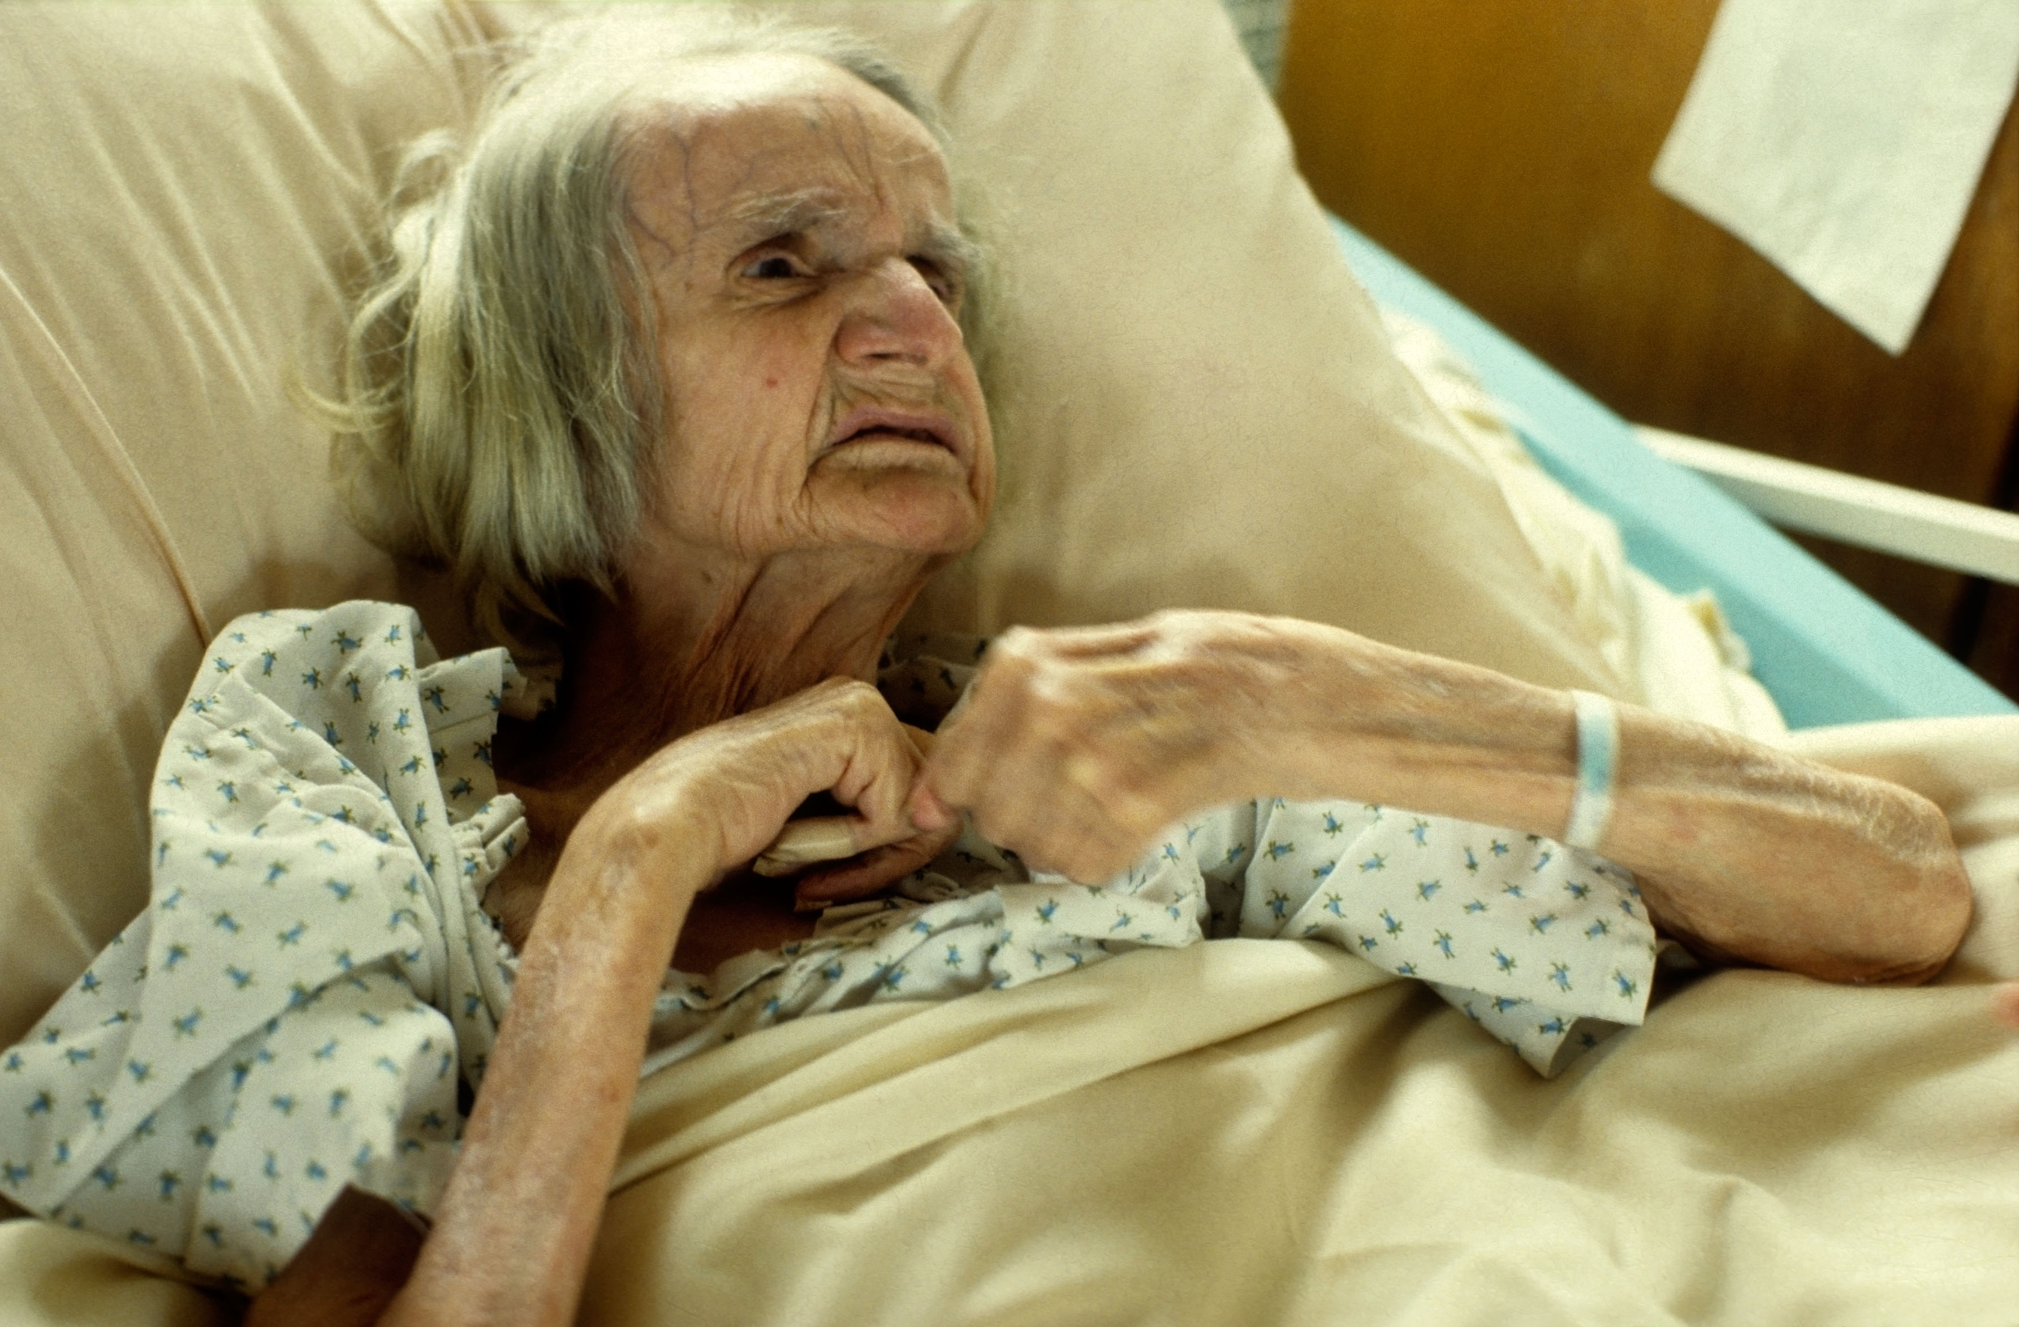
How do you define old?
Third Age: Active Retired
Fourth Age: Frail elderly

Slide 6
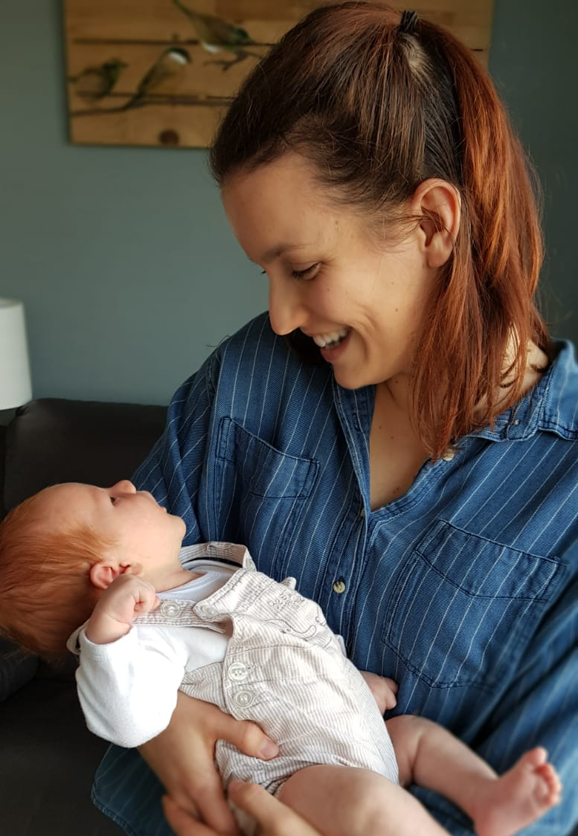

Slide 7
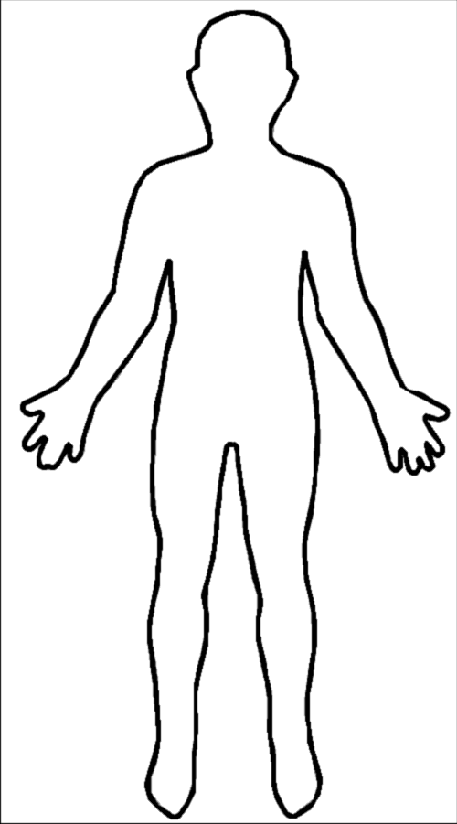
How do we view older people?
Dependent
Created in the image of God
Loved
Relational

Slide 8
a) Dependent
Carry each others burdens and in this way you will fulfil the law of Christ
Galatians 6:2

Slide 9
a) Dependent
b) Created in the
image of God
So God created man in his own image, in the image of God he created him; male and female He created them.”
Genesis 1:27

Slide 10
a) Dependent
b) Created in the image of God
c) Loved
“God shows His love for us in this: While we were still sinners, Christ died for us.
Romans 5:8

Slide 11
a) Dependent
b) Created in the image of God
c) Loved
d) Relational
“It is not good for man to be alone.”
Genesis 2:18

Slide 12
What are we building on these foundations?
What is the aim of our ministry among older people?
Dependent
Loved
Relational
Created in the image of God

Slide 13
