Slide 1
Gemma Gillard Founder

Slide 2
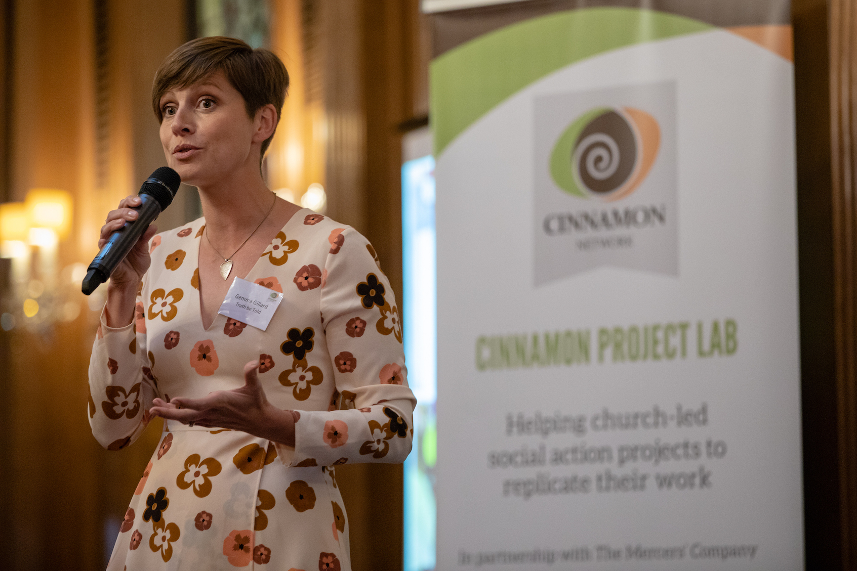
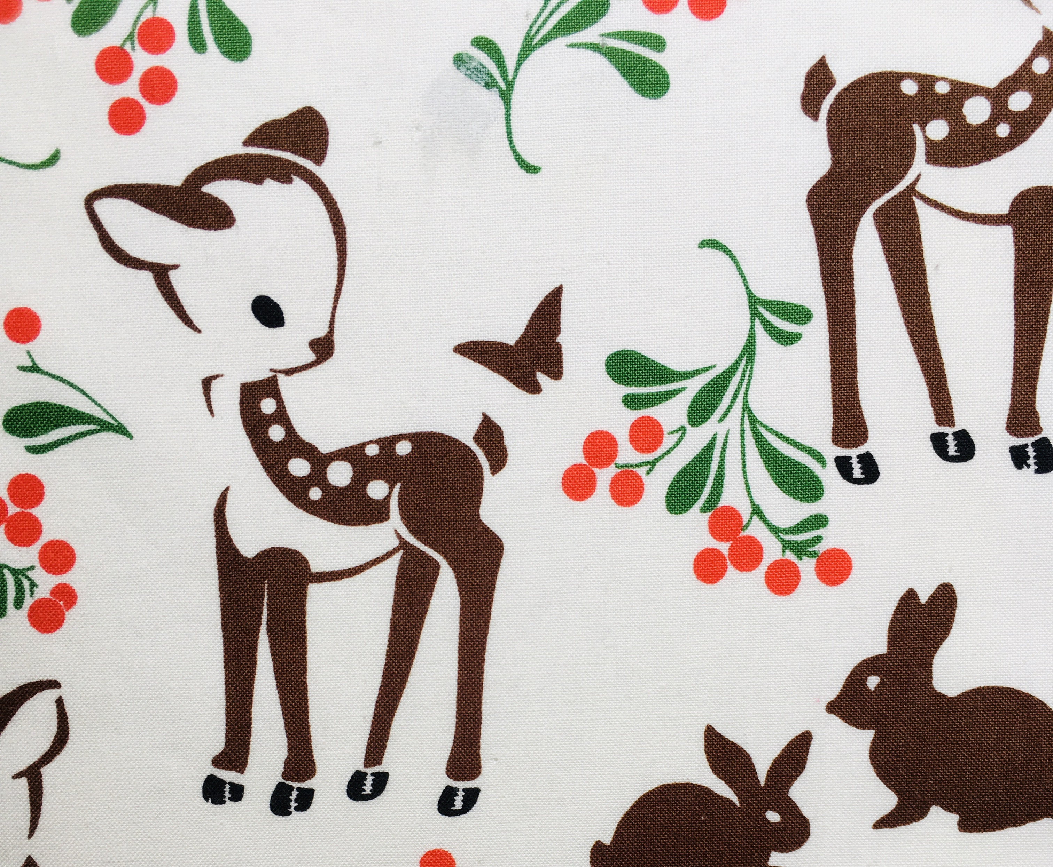
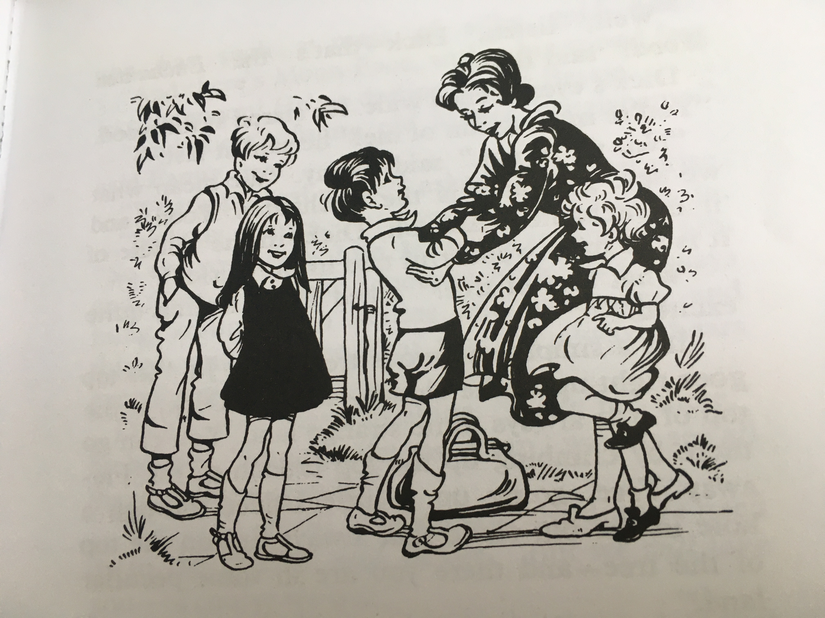
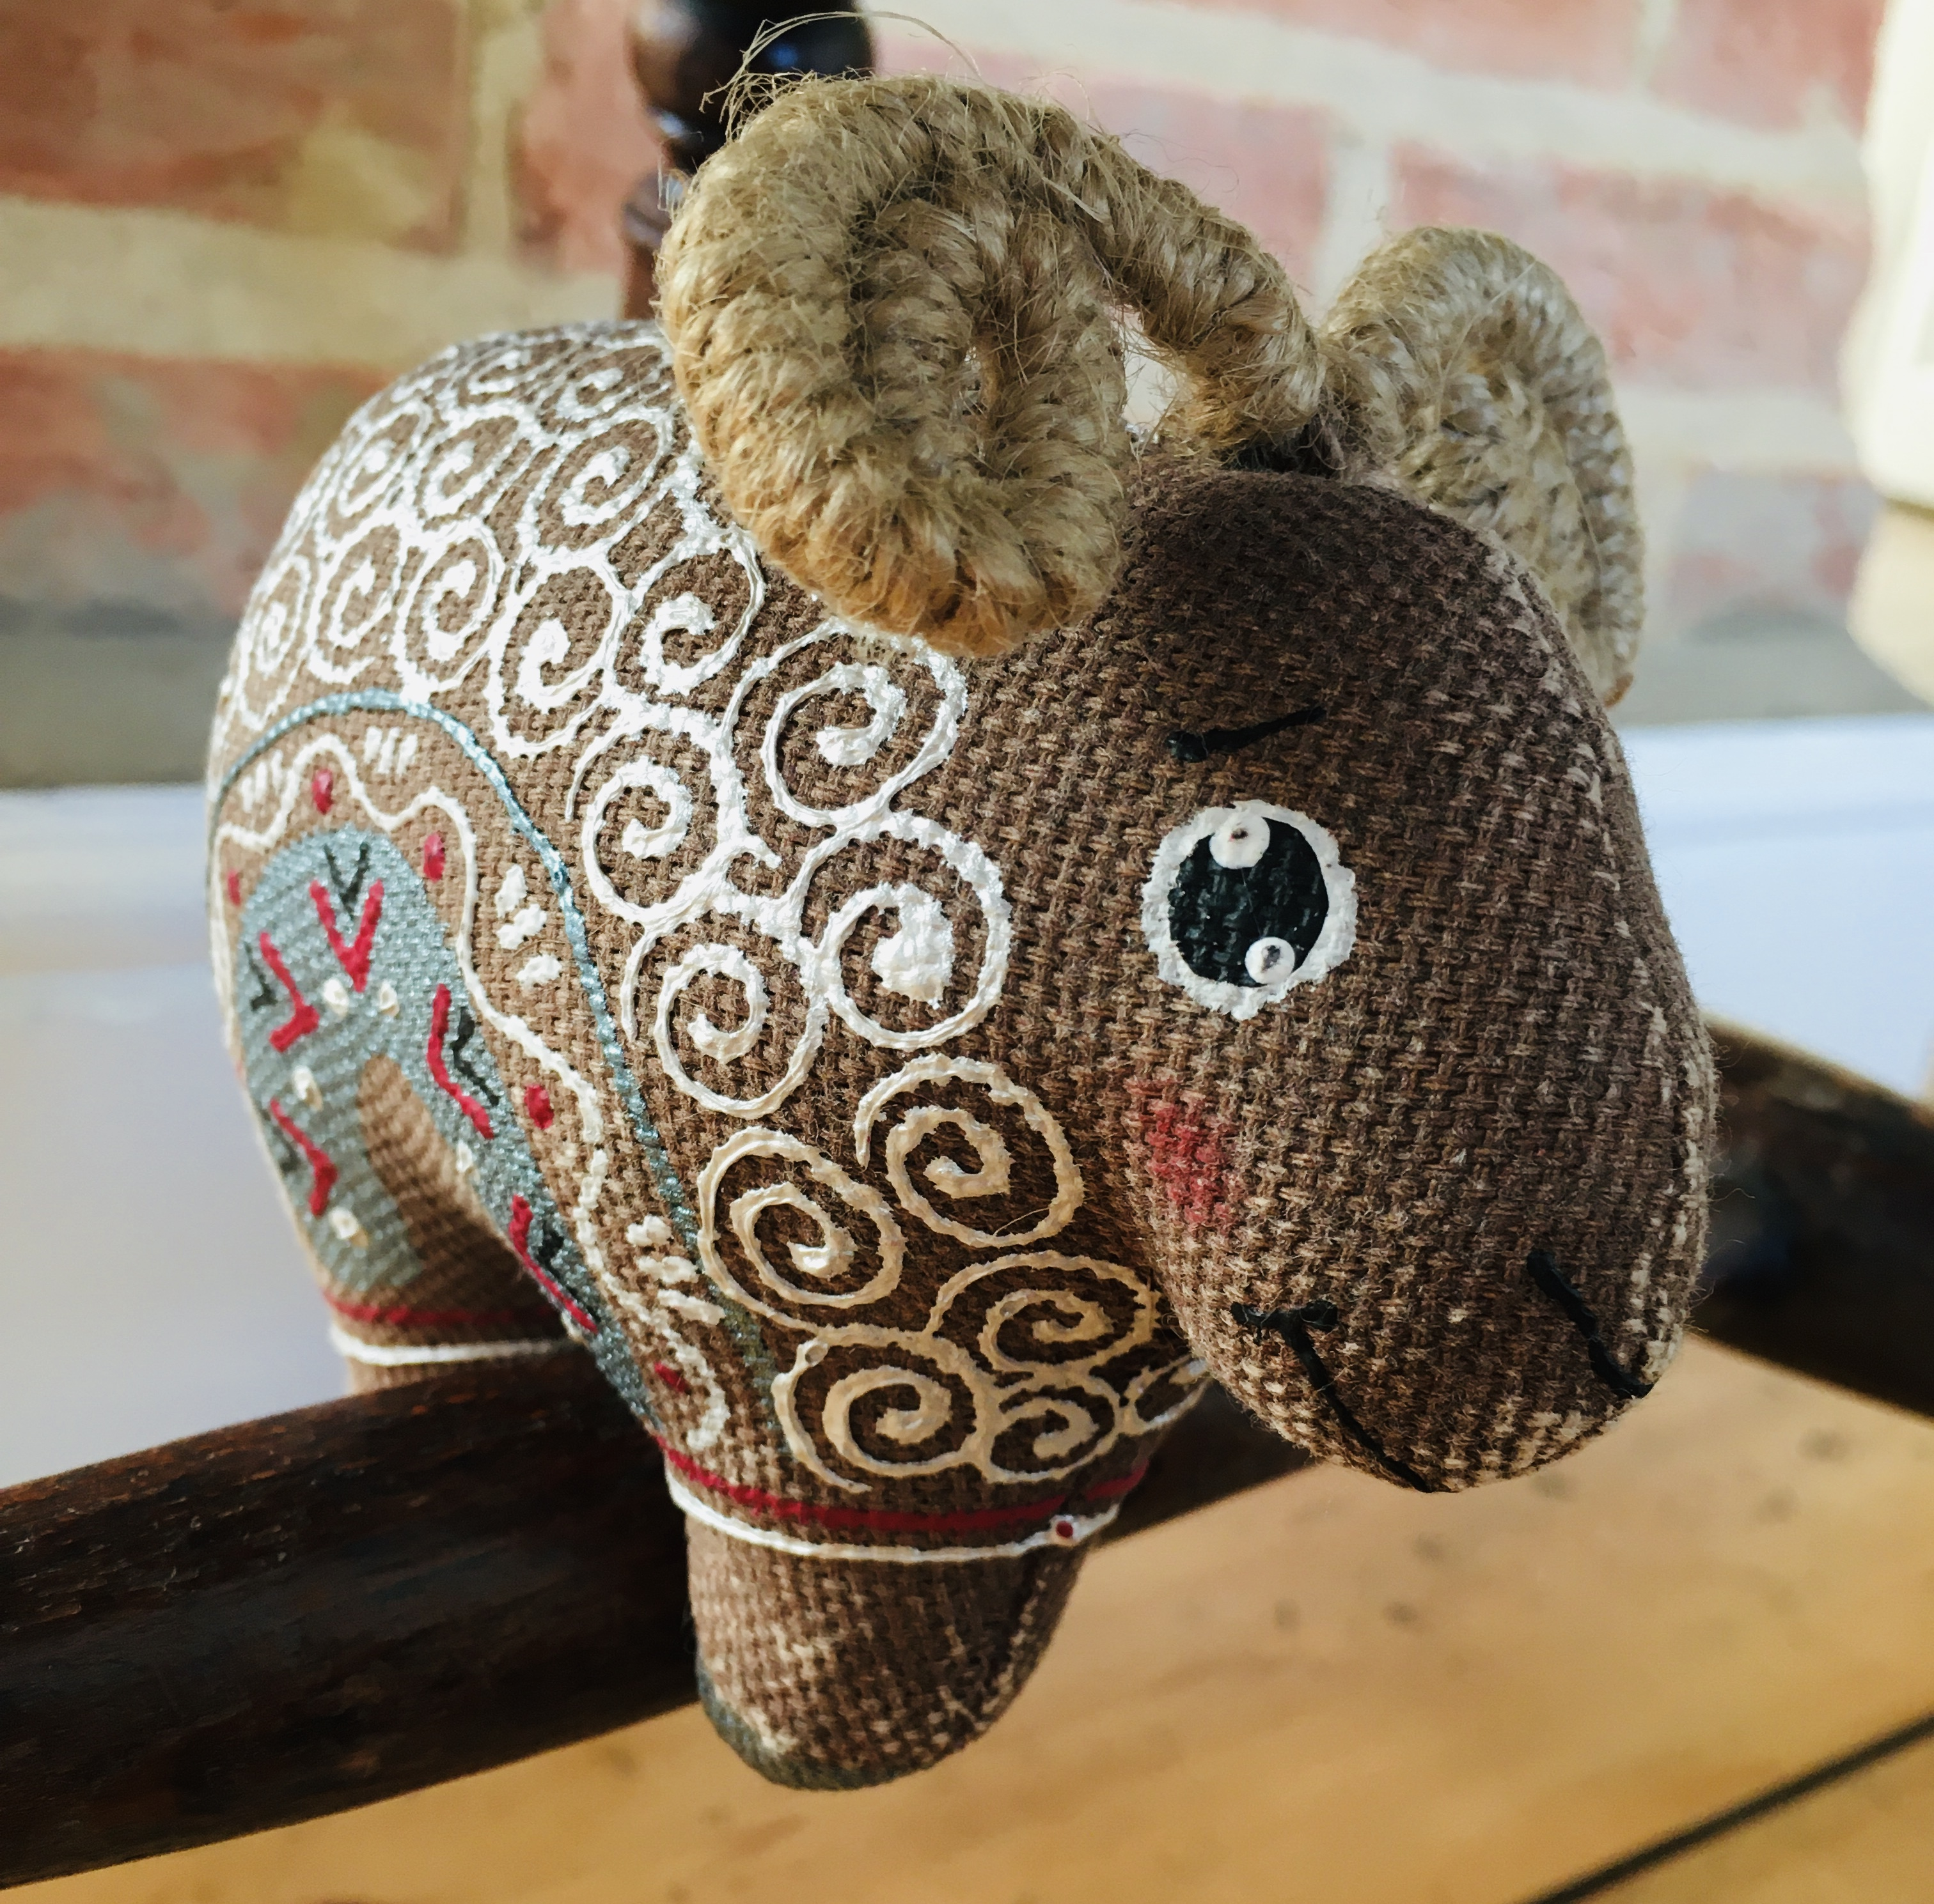
Remember When…

Slide 3
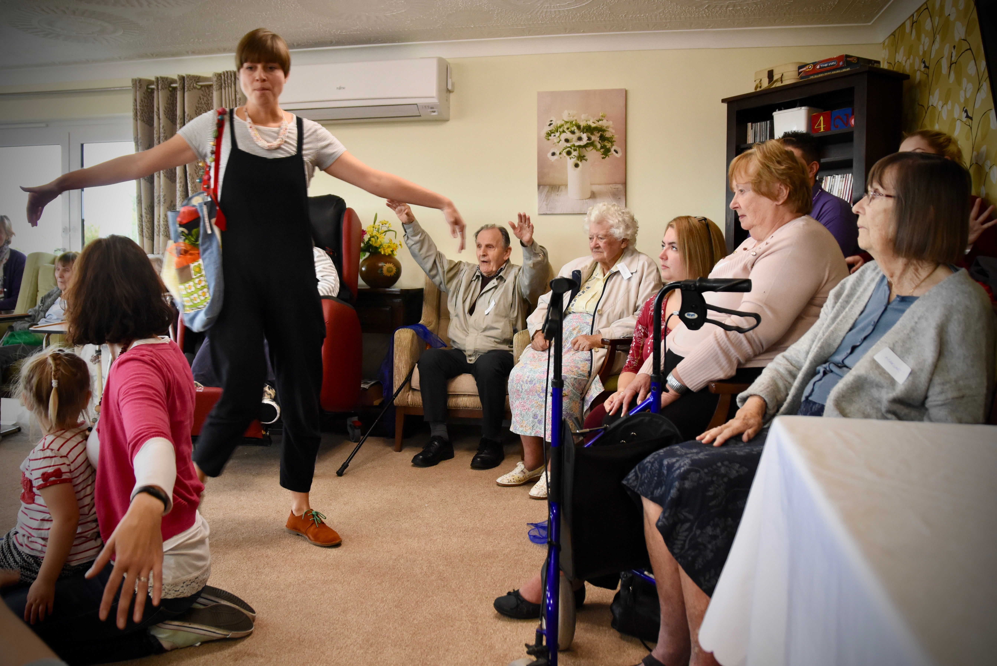
What is Truth Be Told…?
We believe the church is God’s beautiful display of family, of intergenerational love and devotion.
TBT exists to show everyone that they’re invited to belong.
Life, Hope & Joy

Slide 4
Covid & Truth Be Told…

Slide 5
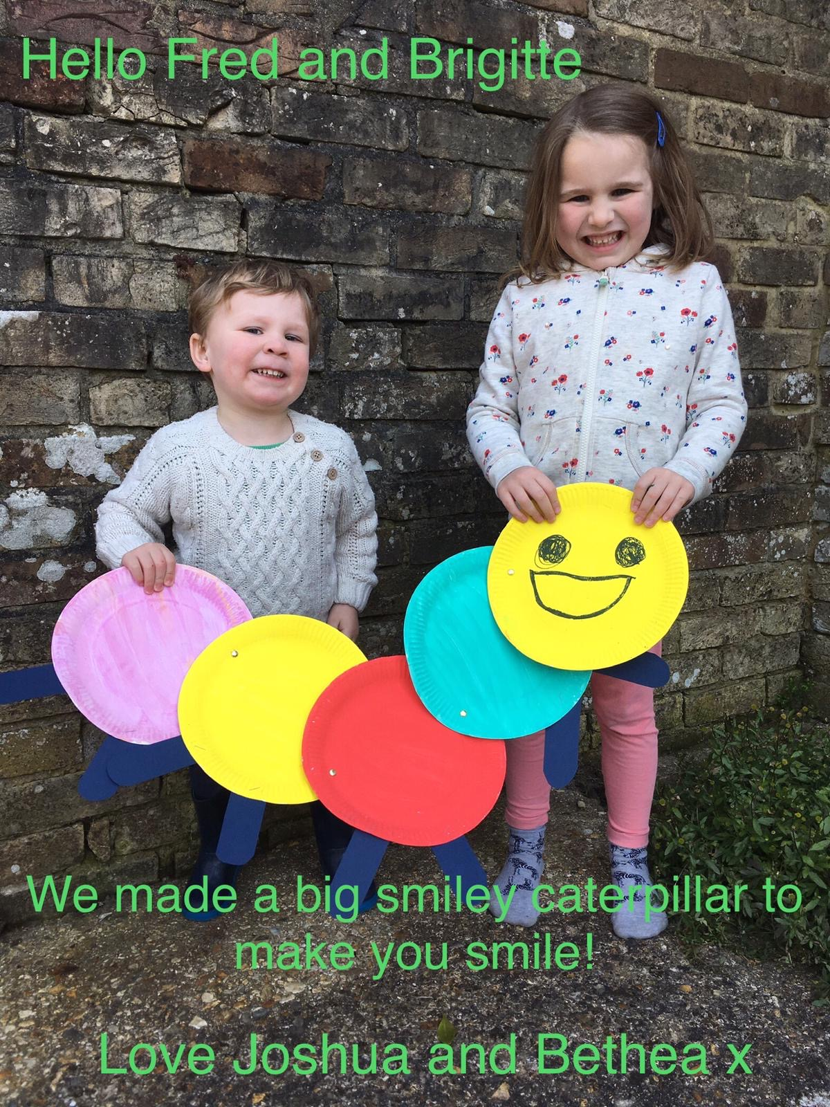
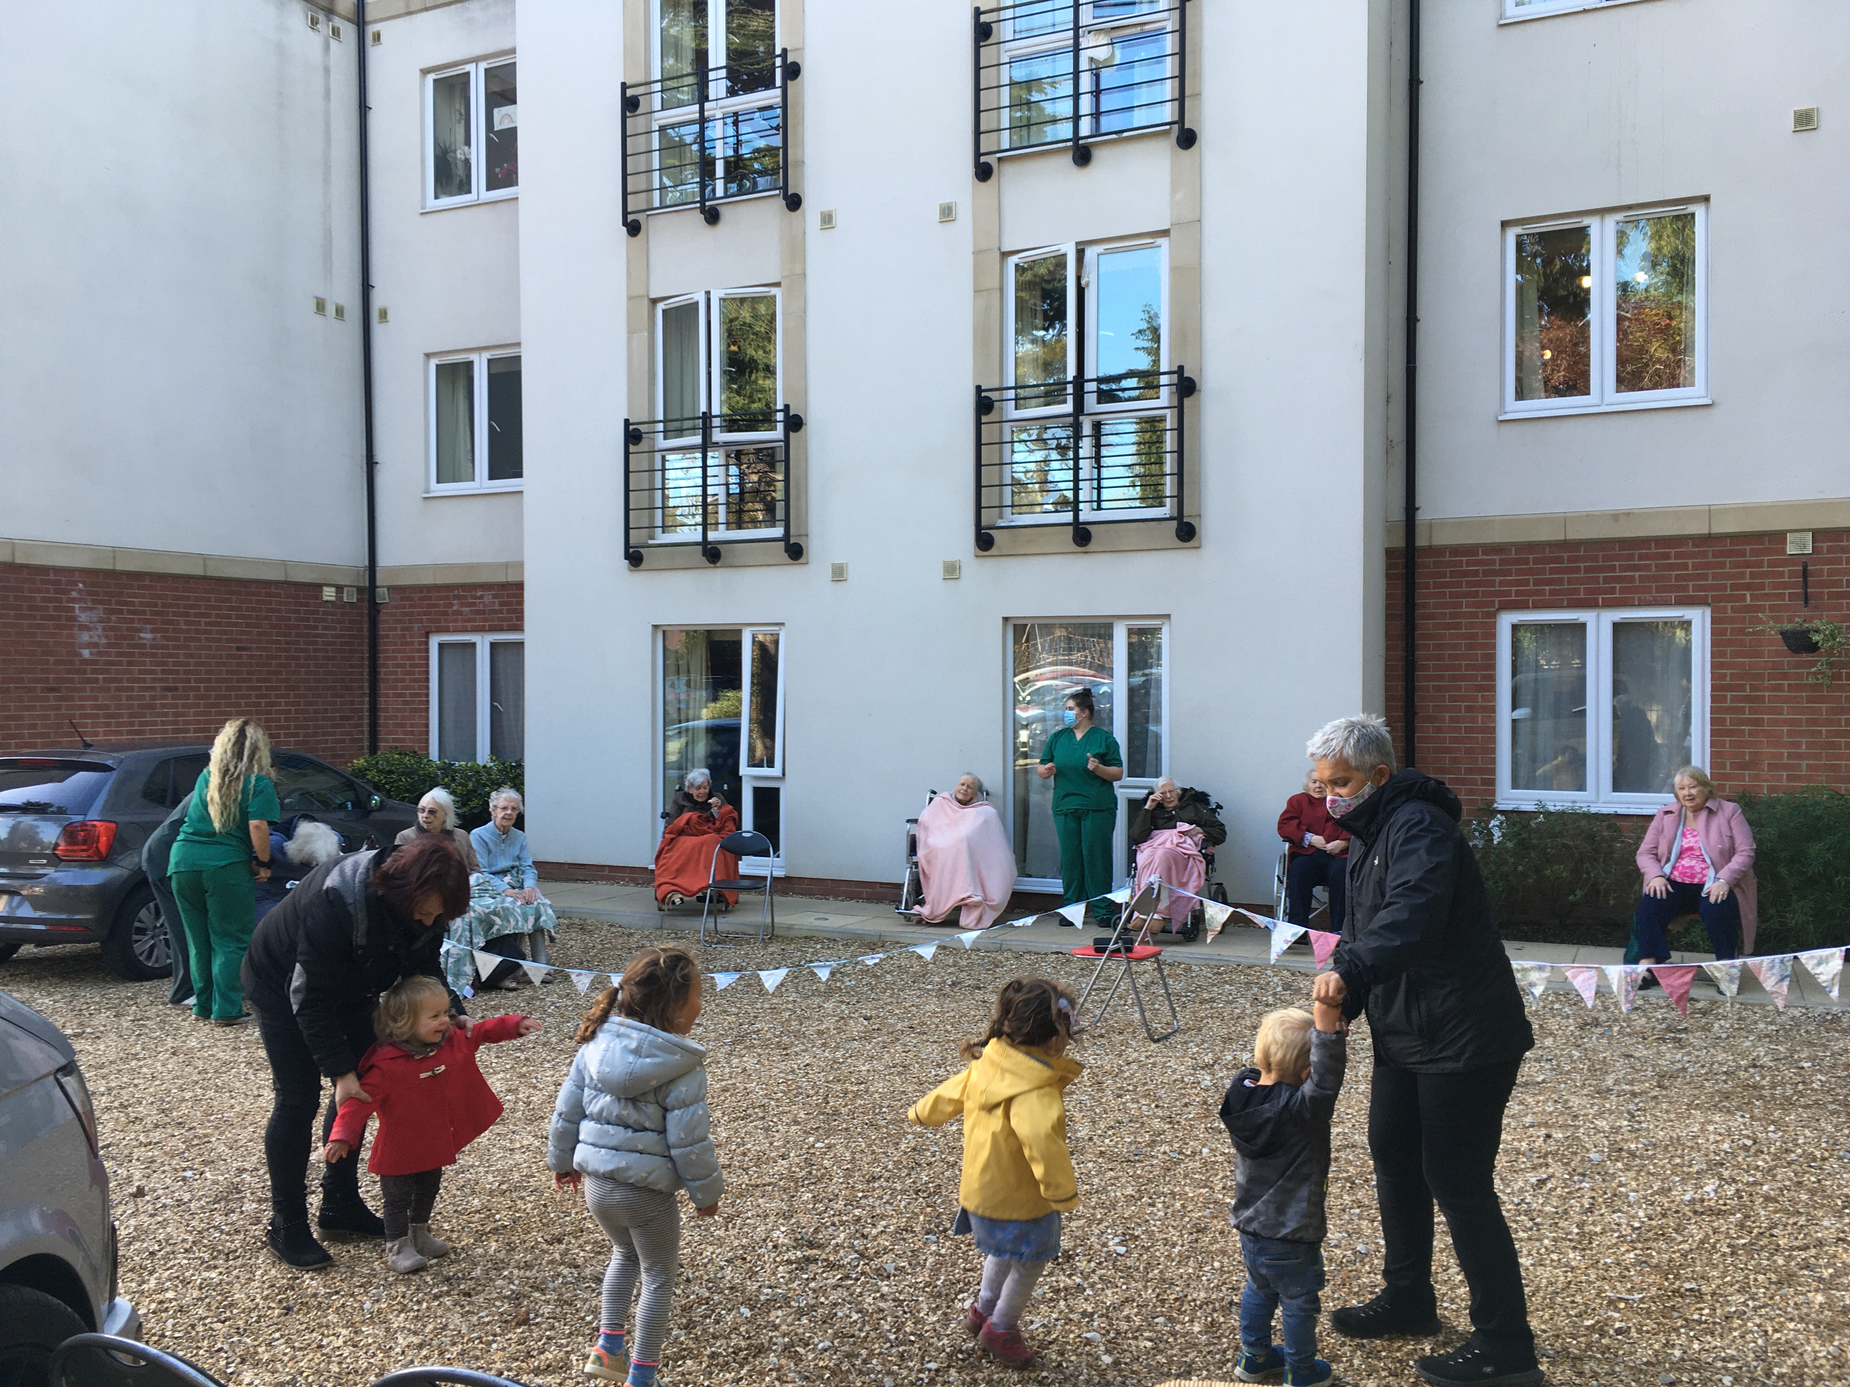
Belonging

Slide 7
Story
Idea’s Bank

Slide 8
Now TBT in churches and communities as well as care homes…
Generativity
Confelicity
Interdependence

Slide 9
Your Intergenerational impact…?
Interdependence?
Confelicity?
Generativity?

Slide 10
I’d love you to get in touch!
www.truthbetold.org.uk
gemma@truthbetold.org.uk
07713 102 676
Twitter TBTCare
Facebook TBTCare
Instagram trutbetold_storytelling

