Slide 1
How the Scriptures show
God’s plan for older people.
And how to revive it, today!
Notes:
We now have the largest generation of older people in history and it's probably the most diverse.

Slide 2
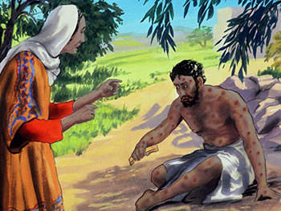
In Scripture, the peak of culture is WISDOM.
‘Those were the days when I went to the city gate and took my place among the honoured leaders.
⁸ The young stepped aside when they saw me, and even the aged rose in respect at my coming.’
Job 29: 7-8
Notes:
Sitting on an ash tip, covered in boils, Job remembers the days when he was an eminent city leader. He said that when he used to go into the council chambers the young moved aside, and even the aged rose in respect at my coming. EVEN THE AGED!

Slide 3
In today’s culture, the peak is YOUTHFULNESS
Youth has become the evaluator.
Within a framework of their value of the person to the ‘economy’
Notes:
‘Evergreen’ –
Sprightly
Very good for his age

Slide 4
Old age – a reward from God
‘With a long life I will satisfy him and let him see My salvation.’ Psalm 91:16
‘… if you walk in my ways, I will prolong your life.’ 1 Kings 13:14
‘you shall go to your fathers in peace; you will be buried at a good old age.’ Genesis 15:15
Notes:
Old age is held out as something special – a blessing.

Slide 5
God designed old age on purpose
To show His faithfulness -to tell out His works (Psalm 78, 71, 145 …)
(Proverbs 4:18) to share experiences and wisdom
To teach and encourage the younger generation, (Titus, Timothy).
To bless the younger, to mentor, to listen.
Notes:
When he put the sun and moon in place with the days and seasons, God created seasons and time and with that old age. Jesus aged. The fall, and sin has led to the vicissitudes of old age – not part of God's original design. But clearly we can see that old age is a blessing, not a diminishing.
With a long life I will satisfy him and let him see my salvation, Psalm 91:26

Slide 6
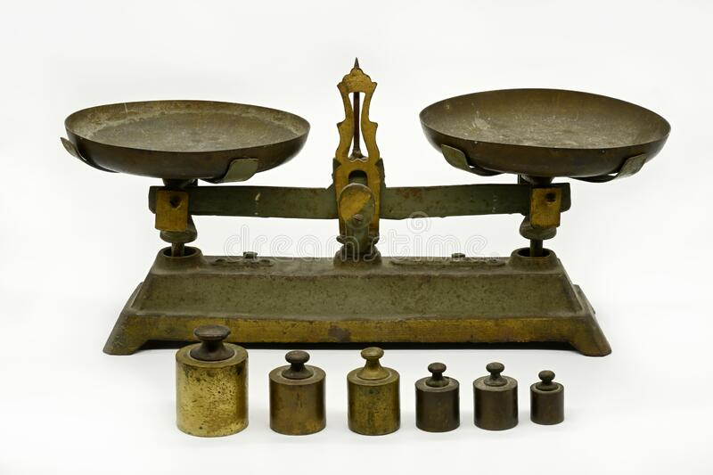
To create a balanced society
‘The glory of the young is their strength; the gray hair of experience (wisdom) is the splendour of the old.’
Proverbs 20:29

Slide 7
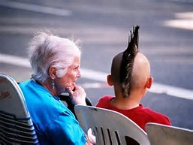
Encouraging, supporting the younger
Mary - Elizabeth and Zechariah
Barnabus - John Mark
Paul - Timothy, Titus, Archippus, Onesimus, and John Mark
  Schooling
  Stimulating
  Supporting
  Strengthening

Slide 8
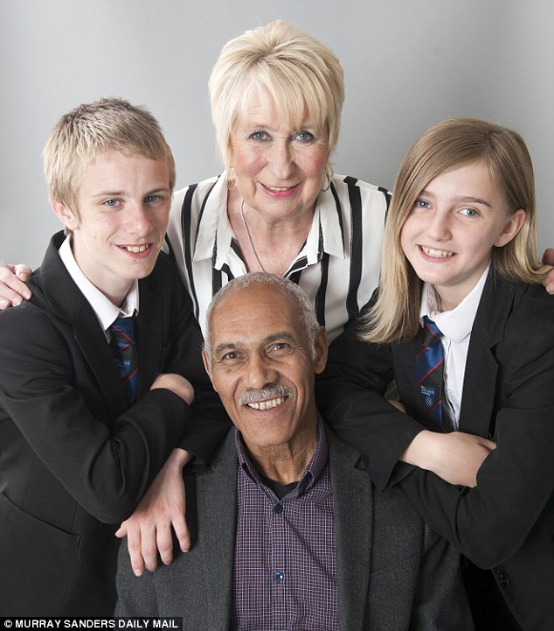
A partnership of pensioners and troubled pupils that turned a school around and transformed the district.
It’s such a simple idea you wonder why it hasn’t been tried before.
http://www.dailymail.co.uk/news/article-3613572/Magical-friendships-troubled-teenagers-link-OAPs-looking-void-lives-transformed.html
Notes:
The idea was born out of research in Japan and the U.S. that suggests getting youngsters together with pensioners not only increases the schoolchildren’s confidence and exam results, but also improves the memory and physical strength of the older participants.
So, the Hairy Bikers, Si King and Dave Myers — who both struggled at school — set about seeing if it could work in Britain. Blackbird Leys, a huge housing estate on the outskirts of Oxford that in the Nineties was plagued by riots and joyriding. Even today, nearly half of the residents live below the poverty line.
On the psychological tests, Tawne’s self-esteem increased from a score of minus one before the experiment to 61 — twice the national average.
And Jacub’s ‘achievement’ score — merit points awarded for good work or behaviour — had soared from seven to 26.
Teachers say this has had a ripple-down effect to other pupils and the Academy is now in the country’s top ten most improving schools.
No wonder they’ve been able to secure £65,000 in grants to continue the project and help roll it out across the country.

Slide 9
Examples of God using older people
Moses – 80 when God called him.
Miriam – 93 when she danced with the timbral
Anna in her 80s, and Simeon (portrayed as old) in the temple –
Joshua, 100, at the battle of Jericho
Caleb, 85, when he said, ‘Give me this mountain.’

Slide 10
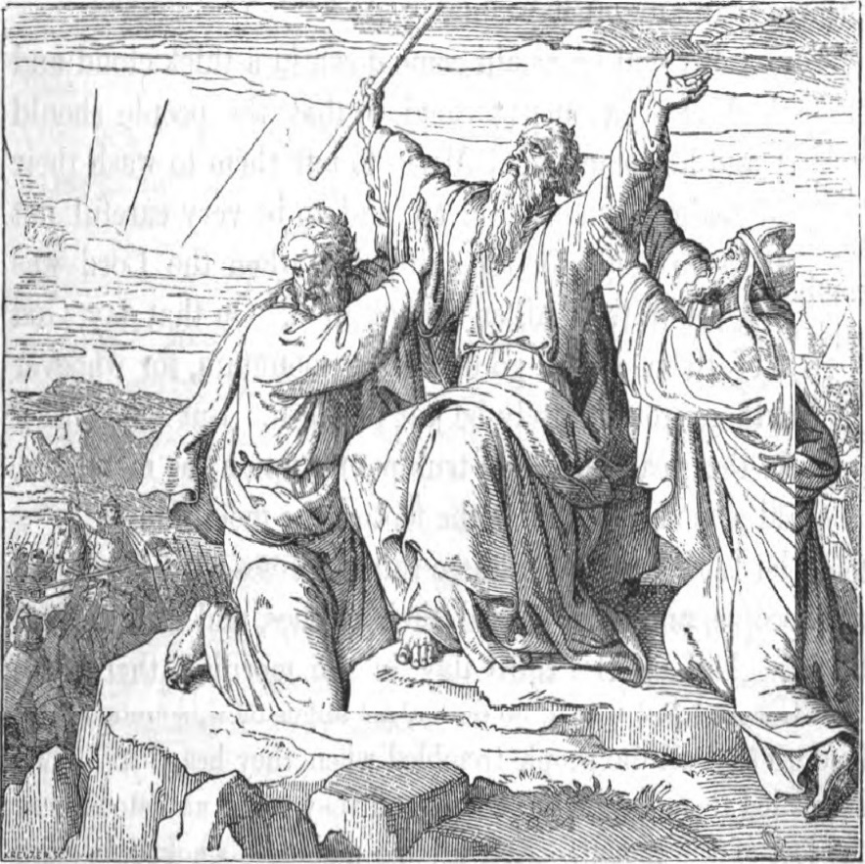
Three ‘old’ men who changed the course of history

Slide 11

Respect in the New Testament
When Paul was writing to Philemon, (whom he had led to the Lord) Paul appealed to him for mercy for his runaway servant Onesimus, saying, 'I, Paul, the aged....' Reminding him that of the respect he was due as an older person.

Slide 12
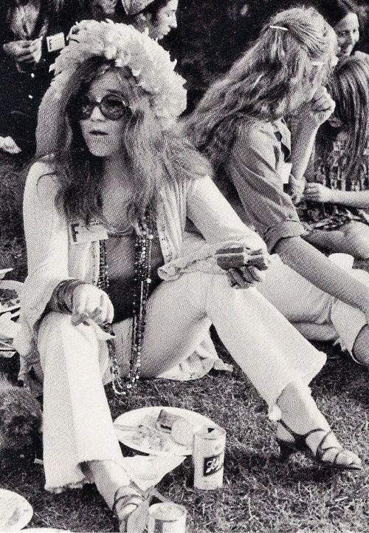
The 1960s social revolution
The late 1960s and early ‘70s saw the Baby Boomer revolution, when traditional values were discarded and older people were devalued. It was a time that exacerbated AGEISM.
Notes:
Neuroscientist Daniel Levitin said:
‘In the 1960s, when I grew up, many young people couldn’t wait to put older people out of the way.
For all the tolerance, peace, and love that our Woodstock generation espoused, we were quick to try to sideline our parents’ generation.
We chanted, “don’t trust anyone over 30,” and we might as well have chanted, “don’t even pay attention to anyone over 70.”
Roger Daltrey of the who summed up a pervasive sense of derision toward the elderly when he sang “I hope I die before I get old.”
My friends who were born in the 1930s and 1940s have shared with me stories of indignities, prejudices, and disrespect shown towards them by people of my generation.’

Slide 13
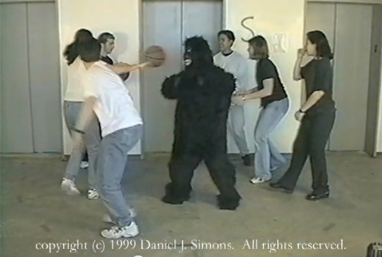
Ageism – our invisible gorilla
To be old means to be nothing. To be invisible, to be not wanted on voyage.
Notes:
‘
The term ageism was coined in 1969 by psychologist and social activist Rob Butler.

Slide 14
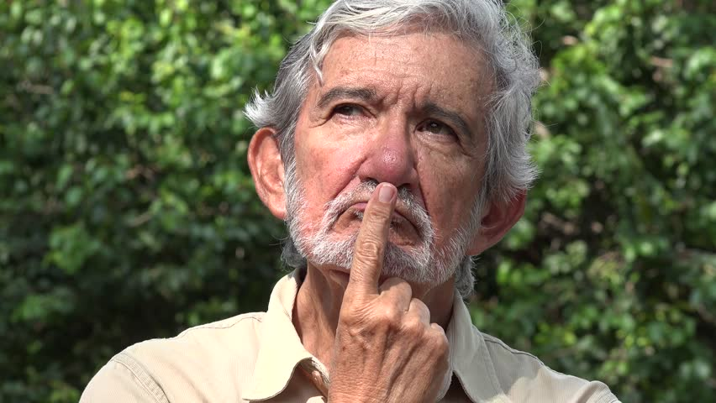
So how do you expect to be in your old age?
Notes:
Sense that there is. New Wine 2014 - both weeks, the marquee tent almost full. Much interest. Question time – doctor took mic asked why Christians were afraid of death. Had to almost wrestle mic off her - lady – this is about LIFE TO THE FULL HERE AND NOW! Have you missed the point?

Slide 15
THE KEY
For we are His workmanship, created in Christ Jesus for good works, which God prepared beforehand that we should walk in them. Ephesians 2:10
Whatever your right hand finds to do, do it with all your strength - Ecclesiastes 9:10
Notes:
I wish this verse were preached on more often.
God has prepared our good works BEFOREHAND - older people sometimes say they don’t know what their purpose is.
But according to this – God has prepared it already. Stick close to God and you’ll often sense it before it comes. But He’ll bring it to you anyway …
No date stamp in Ephesians 2:10. We may retire from our salaried jobs, but we never retire from God’s purpose.
We all need a sense of purpose.

Slide 16
Churches raising expectations
Recognising God’s role for older people
RAISE expectations - teach on their value and purpose
Train, don’t just teach
Send them, don’t just tend them
Involve as co-workers
Notes:
.

Slide 17

For copy and notes: email louise.morse@pilgrimsfriend.org.uk
"Grow old along with me!
The best is yet to be,
The last of life, for which the first was made:
Our times are in His Hand
Who saith "A whole I planned,
Youth shows but half; trust God: see all, nor be afraid!”
Robert Browning

