Slide 1





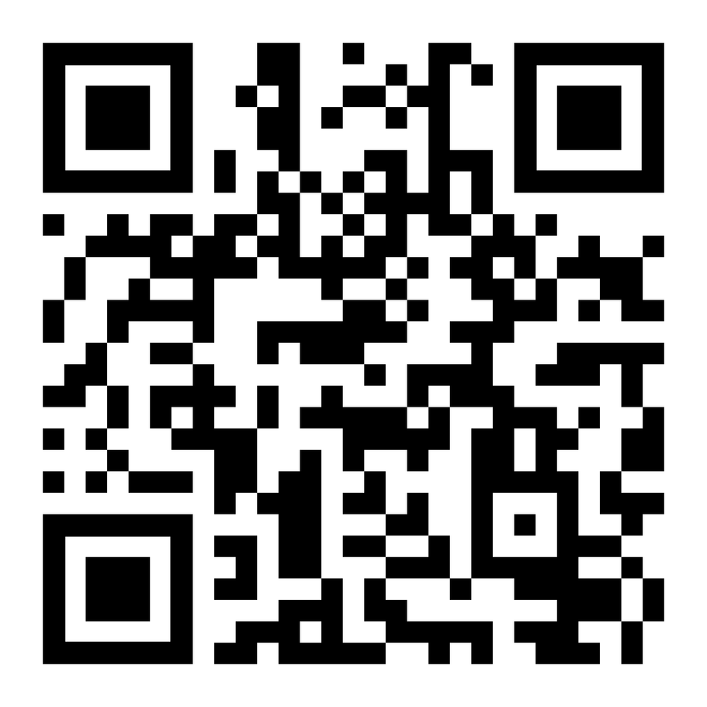

Are you ready to
help people have
faith in later life?
Here
to inspire
and equip
churches
Join the network today!

Slide 2


Slide 3
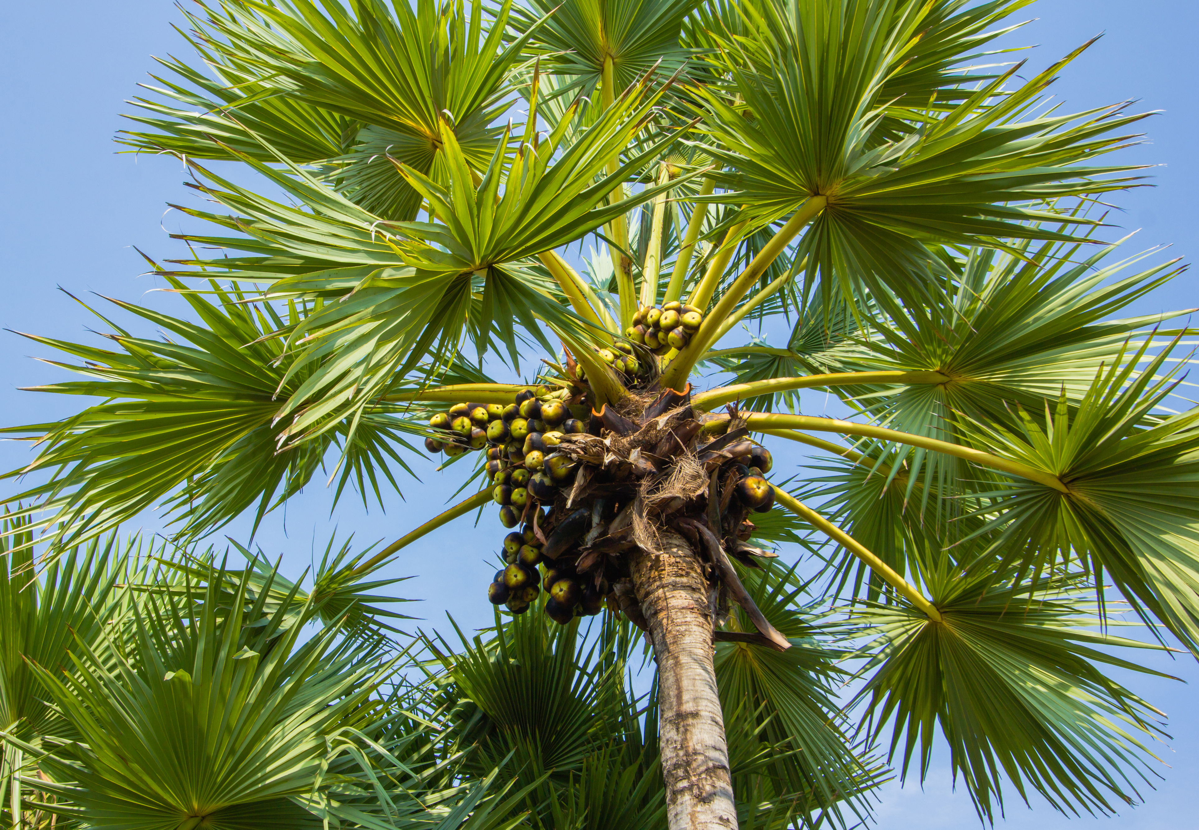

The righteous will flourish like a palm tree, they will grow like a cedar of Lebanon; planted in the house of the Lord, they will flourish in the courts of our God. They will still bear fruit in old age, they will stay fresh and green, proclaiming, ‘The Lord is upright; he is my Rock, and there is no wickedness in him’
Psalm 92: 12-15

Slide 4





www.faithinlaterlife.org
@faithinlaterlife

